Slide 2
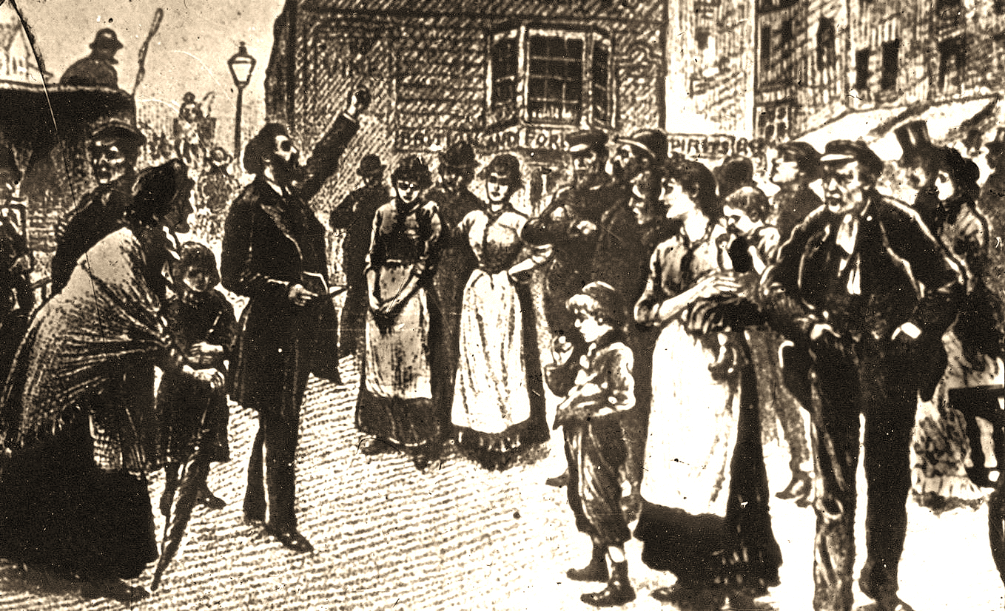

Slide 3
ASSURANCE OF HIS RETURN
John 16:16-33
The fact that Jesus is coming back…
TURNS GRIEF TO JOY (16:16-22)
When we understand what He’s saying. (vs. 16-20)
- “a little while and you will no longer see Me”
- “again a little while and you will see Me”
- “What is this thing He is telling us?”
- “Jesus knew that they wished to question Him” (John 2:25)
- “Are you deliberating together about this?”
- “your grief will be turned into joy”

Slide 4
ASSURANCE OF HIS RETURN
John 16:16-33
The fact that Jesus is coming back…
TURNS GRIEF TO JOY (16:16-22)
When we understand what He’s saying. (vs. 16-20)
When we grasp what this means. (vs. 21-22)
- “a woman in labor has pain…but when she gives birth…she no longer
remembers the anguish”
- “because of the joy that a child has been born”
-“you have grief now, but I will see you again, and your heart will rejoice”
- “no one will take your joy away from you” (I Corinthians 15:13-17)

Slide 5
ASSURANCE OF HIS RETURN
John 16:16-33
The fact that Jesus is coming back…
TURNS GRIEF TO JOY (16:16-22)
TURNS DOUBT TO FAITH (16:23-28)
When we understand the relationship between the Father and the Son.
- “in that day you will not question Me about anything”
- “if you ask the Father for anything in My name, He will give it to you”
- “Until now you have asked for nothing in My name; ask and you will
receive, so that your joy may be full.”
(vs. 23-25)

Slide 6
ASSURANCE OF HIS RETURN
John 16:16-33
The fact that Jesus is coming back…
TURNS GRIEF TO JOY (16:16-22)
TURNS DOUBT TO FAITH (16:23-28)
When we understand the relationship between the Father and the Son.
When we grasp what that relationship means for us. (vs. 26-28)
- “I have spoken to you in figurative language…” (Matthew 13:10-13)
- “I do not say that I will request of the Father on your behalf”
- “the Father Himself loves you, because you have loved Me”
- “I came forth…have come…am leaving…and going to the Father.”

Slide 7
ASSURANCE OF HIS RETURN
John 16:16-33
The fact that Jesus is coming back…
TURNS GRIEF TO JOY (16:16-22)
TURNS DOUBT TO FAITH (16:23-28)
TURNS FEAR TO PEACE (16:29-33)
When we understand that Jesus’ power is that of the Father. (vs. 29-32)
- “now You are speaking plainly…and we know that You know all things”
- “by this we believe that You came from God”

Slide 8
ASSURANCE OF HIS RETURN
John 16:16-33
The fact that Jesus is coming back…
TURNS GRIEF TO JOY (16:16-22)
TURNS DOUBT TO FAITH (16:23-28)
TURNS FEAR TO PEACE (16:29-33)
When we understand that Jesus’ power is that of the Father. (vs. 29-32)
When we grasp that Jesus’ victory is actually ours. (vs. 33)
- “Do you now believe?”
- “and hour is coming…for you to be scattered…and to leave Me alone”
- “yet I am not alone, because the Father is with Me”

Slide 9
ASSURANCE OF HIS RETURN
John 16:16-33
The fact that Jesus is coming back…
TURNS GRIEF TO JOY (16:16-22)
TURNS DOUBT TO FAITH (16:23-28)
TURNS FEAR TO PEACE (16:29-33)
When we understand that Jesus’ power is that of the Father. (vs. 29-32)
When we grasp that Jesus’ victory is actually ours. (vs. 33)
- “these things I have spoken to you, so that in Me you may have peace”
- “In the world you have tribulation, but take courage; I have overcome
the world.”

Slide 10
ASSURANCE OF HIS RETURN
John 16:16-33
Conclusion:
In times of suffering, spend more time in God’s Word.
In times of suffering, spend more time in prayer.
In times of suffering, speak more of your Savior to others.
In times of suffering, remember His promise to return for you.

