Slide 2
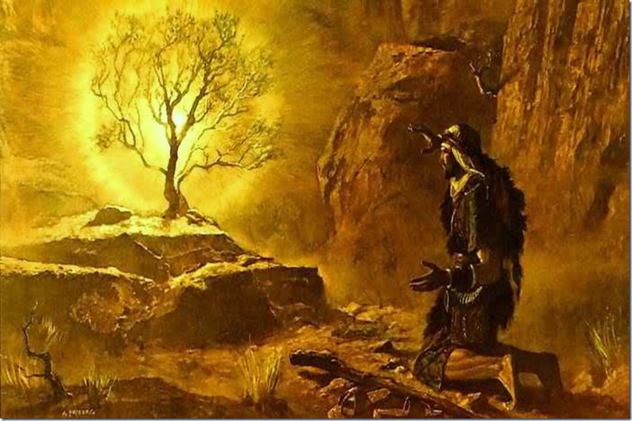
“The seventeenth chapter of the Gospel by John, is, without doubt, the most remarkable portion of the most remarkable book in the world.”
John Brown

Slide 3
Outline of Jesus’ High Priestly Prayer:
for Himself (vs. 1 - 5)
for His disciples (vs. 6 - 19)
for all believers (vs. 20 - 26)

Slide 4
JESUS’ HIGH PRIESTLY PRAYER
(for Himself)
John 17:1-5
HIS POWERFUL REDEMPTION (17:1-2)
1) His Sonship (vs. 1)
- “Jesus spoke these things” (14:25; 16:1, 4, 26, 33)
- “lifting up His eyes to heaven”
- “Father, the hour has come”
- “glorify Your Son, that the Son may glorify You” (Isaiah 42:8, 11)

Slide 5
JESUS’ HIGH PRIESTLY PRAYER
(for Himself)
John 17:1-5
HIS POWERFUL REDEMPTION (17:1-2)
1) His Sonship (vs. 1)
2) His Sovereignty (vs. 2)
- “even as You gave Him authority over all flesh”
- “that to all whom You have given Him, He may give eternal life”
vs. 6, 9, 24
John 6:37, 39
Ephesians 1:4, 11

Slide 6
JESUS’ HIGH PRIESTLY PRAYER
(for Himself)
John 17:1-5
HIS POWERFUL REDEMPTION (17:1-2)
1) His Sonship (vs. 1)
2) His Sovereignty (vs. 2)
HIS PURPOSEFUL REPRESENTATION (17:3)
3) His Salvific Work (vs. 3)
- “this is eternal life, that they may know You”
- “the only true God”
- “and Jesus Christ whom You have sent” (1: 18; 3:35-36; 14:9)
Matthew 11:27

Slide 7
JESUS’ HIGH PRIESTLY PRAYER
(for Himself)
John 17:1-5
HIS POWERFUL REDEMPTION (17:1-2)
1) His Sonship (vs. 1)
2) His Sovereignty (vs. 2)
HIS PURPOSEFUL REPRESENTATION (17:3)
3) His Salvific Work (vs. 3)
HIS PERFECT RELATIONSHIP (17:4-5)
4) His Service (vs. 4)
- “I glorified You on the earth”
- “having accomplished the work which You have given Me to do”

Slide 8
JESUS’ HIGH PRIESTLY PRAYER
(for Himself)
John 17:1-5
HIS POWERFUL REDEMPTION (17:1-2)
1) His Sonship (vs. 1)
2) His Sovereignty (vs. 2)
HIS PURPOSEFUL REPRESENTATION (17:3)
3) His Salvific Work (vs. 3)
HIS PERFECT RELATIONSHIP (17:4-5)
4) His Service (vs. 4)
5) His Status (vs. 5)
- “now, Father, glorify Me together with Yourself”

Slide 9
JESUS’ HIGH PRIESTLY PRAYER
(for Himself)
John 17:1-5
HIS POWERFUL REDEMPTION (17:1-2)
1) His Sonship (vs. 1)
2) His Sovereignty (vs. 2)
HIS PURPOSEFUL REPRESENTATION (17:3)
3) His Salvific Work (vs. 3)
HIS PERFECT RELATIONSHIP (17:4-5)
4) His Service (vs. 4)
5) His Status (vs. 5)
- “with the glory which I had with You before the world was”

Slide 10
JESUS’ HIGH PRIESTLY PRAYER
(for Himself)
John 17:1-5
Conclusion:
“A godly man cannot live without prayer. A man cannot live unless he takes his breath, nor can the soul, unless it breathes for the its desires to God.” - Thomas Watson

