Slide 2
The Kurvits Family

Slide 3
2,000

Slide 6
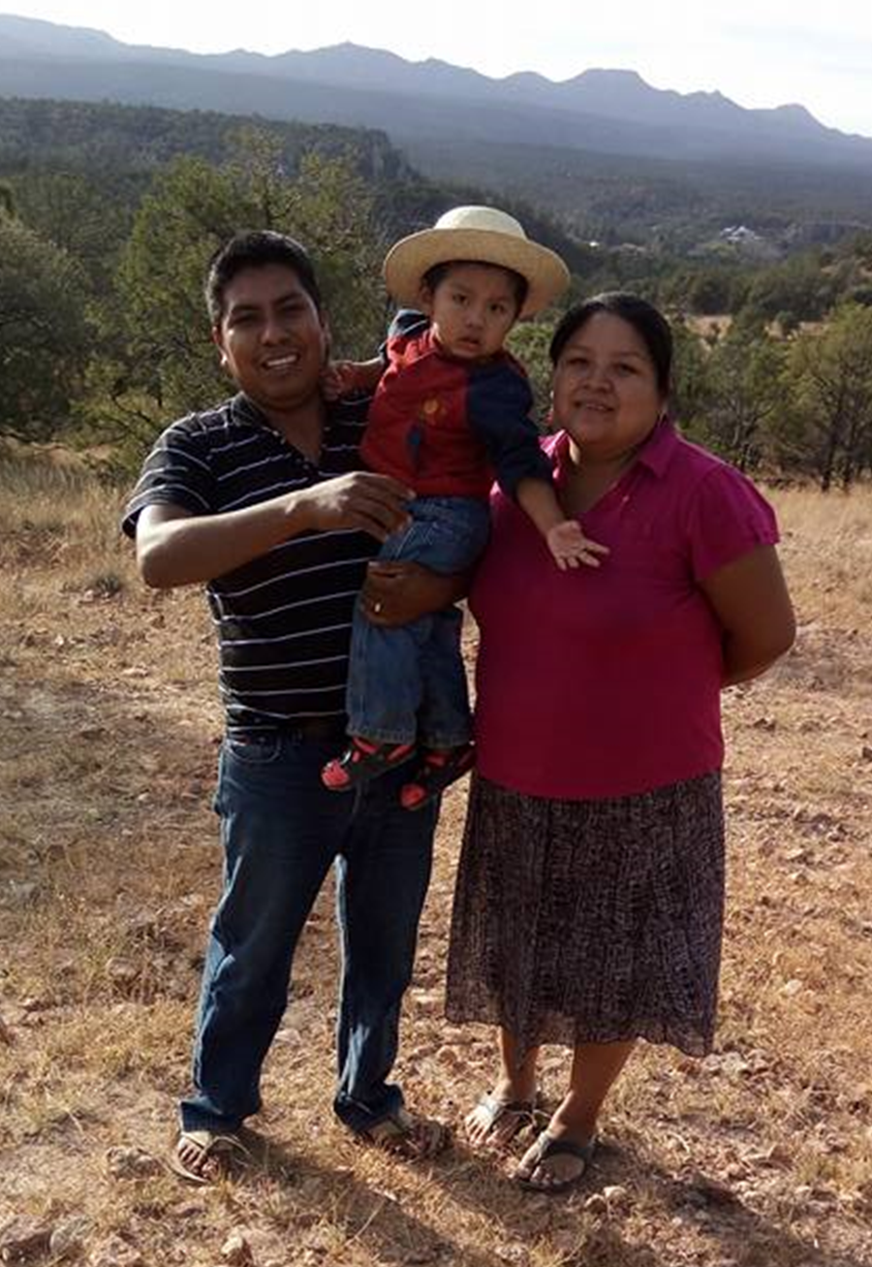

Slide 7
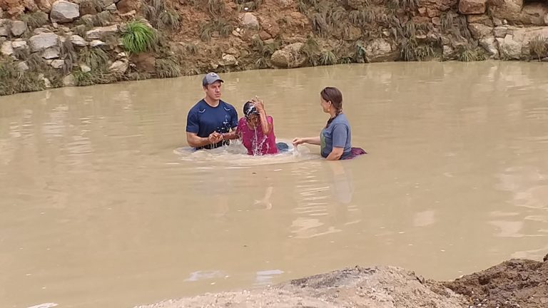
“We always knew there was a God, but now we know what He’s like.”

Slide 8
Psalm 78
Can the Lord prepare a table in the wilderness?

Slide 9
Man’s Condition & God’s Character

Slide 10
vs. 1-7

Slide 11
vs. 7 “that they should put their confidence in God”

Slide 12
“Like no other generation before, Generation Z faces a widening chasm between wisdom and information.” - James Emery White

Slide 13
vs. 2 (NET) “I will sing a song that imparts wisdom.”

Slide 14
vs. 8-11

Slide 15
vs. 12-16

Slide 16
vs. 17-20

Slide 17
Vs. 19 “Can God prepare a table in the wilderness?”

Slide 18
Vs. 20 (NLT) “Yes, He can strike a rock so water gushes out, but He can’t give his people bread and meat.”

Slide 20
Mark 8

Slide 21
Mark 8:18 “Having eyes, do you not see? And having ears, do you not hear? And do you not remember…”

Slide 23
vs. 21-22

Slide 24
Vs. 22 “For they did not believe God or trust Him to care for them.”

Slide 25
vs. 23-29

Slide 26
vs. 30-35

Slide 27
vs. 36-39

Slide 28
Vs. 39 “Thus He remembered that they were but flesh…”

Slide 29
vs. 65-72

Slide 30
Man’s Condition is not good!

Slide 31
God’s Character is always good!

Slide 34
vs. 70-72

Slide 35
Matthew 4:4 “Man shall not live by bread alone but on every word that proceeds from the mouth of God.”

