Slide 2
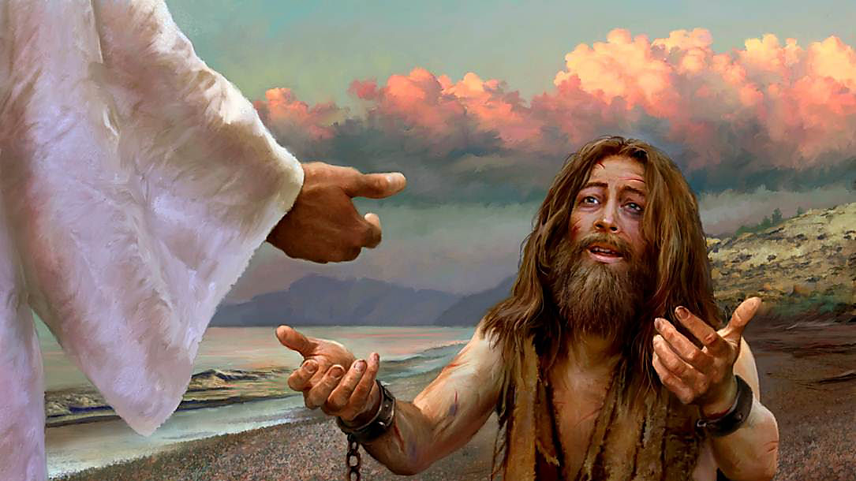

Slide 3
The Delivery of a Demoniac
Mark 5:1-20
The Gospel According to Mark
4:35-41 Danger (calming the storm)
5:1-20 Demons (the “maniac” of Gadera)
5:21-34 Disease (the women with the issue of blood)
5:35-43 Death (Jairus’ daughter)

Slide 4
The Delivery of a Demoniac
Mark 5:1-20
The Gospel According to Mark
THE CONFRONTATION WITH MULTIPLE DEMONS (vs. 1-13)
The District (vs. 1)
- “the other side”
- “Gerasenes”

Slide 5
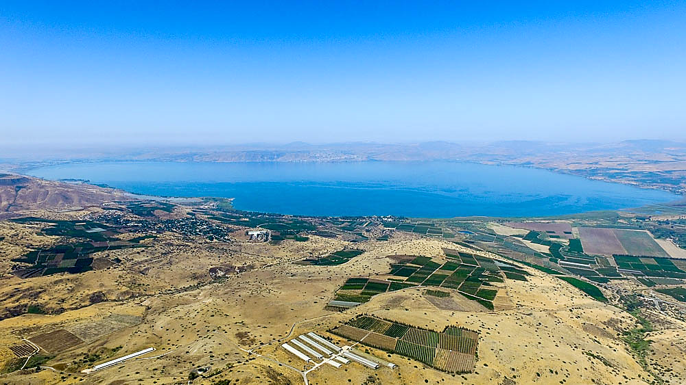

Slide 6
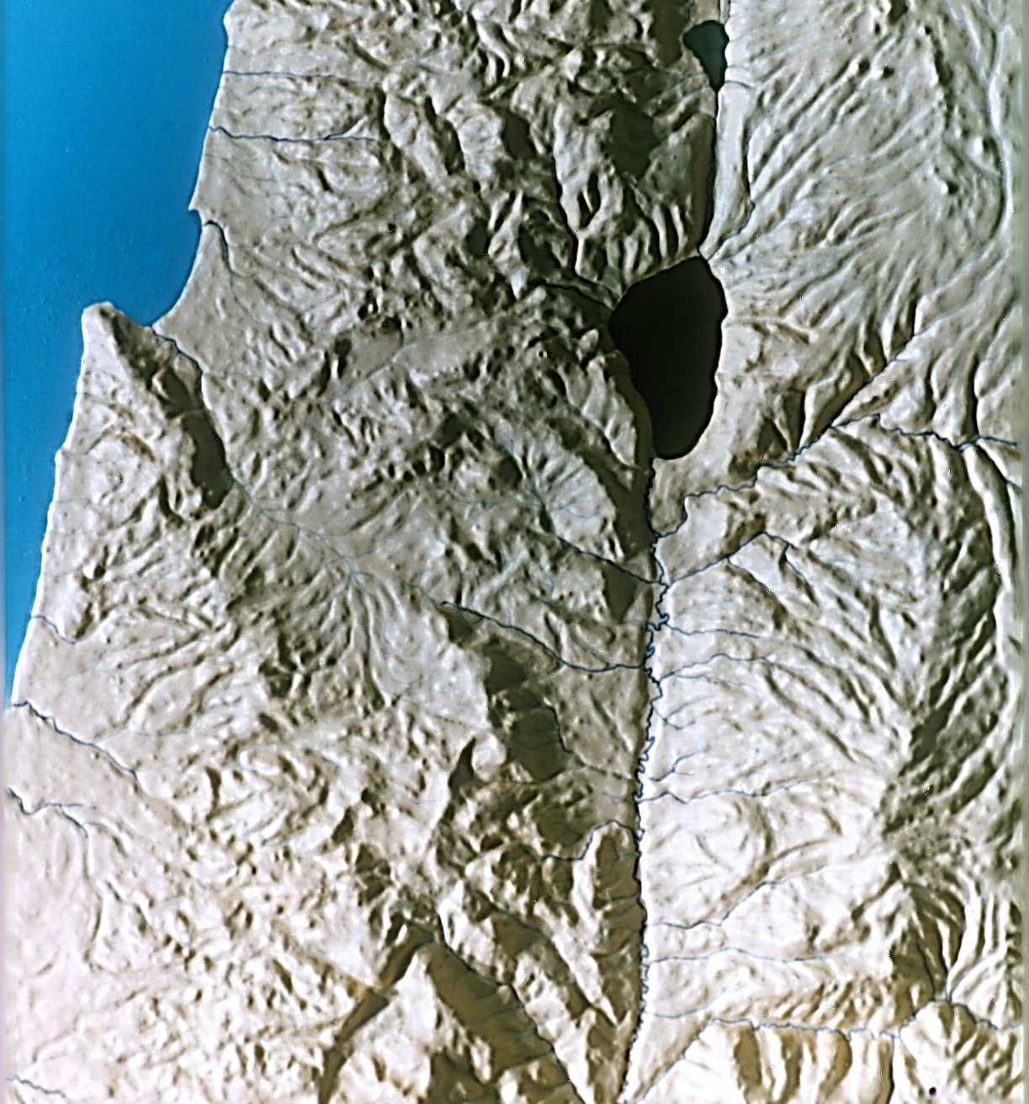
Matthew 8:28
(ESV, JB, NASB, NLT, RSV)
40 miles SE of the Sea of Galilee
- no harbor
- no tombs
- no steep slope
GERASA /
JERASH

Slide 7
Matthew 8:28
(KJV)
6 miles SE of the Sea of Galilee
- notable harbor
- no tombs
- no steep slope
GADERA/
UM QAIS

Slide 8
Mark 5:1; Luke 8:26, 37
(Origin, NIC, NEB)
on the Sea of Galilee
- harbor
- tombs
- steep slope
- Byzantine church on site
GERGESA/
KURSI

Slide 9
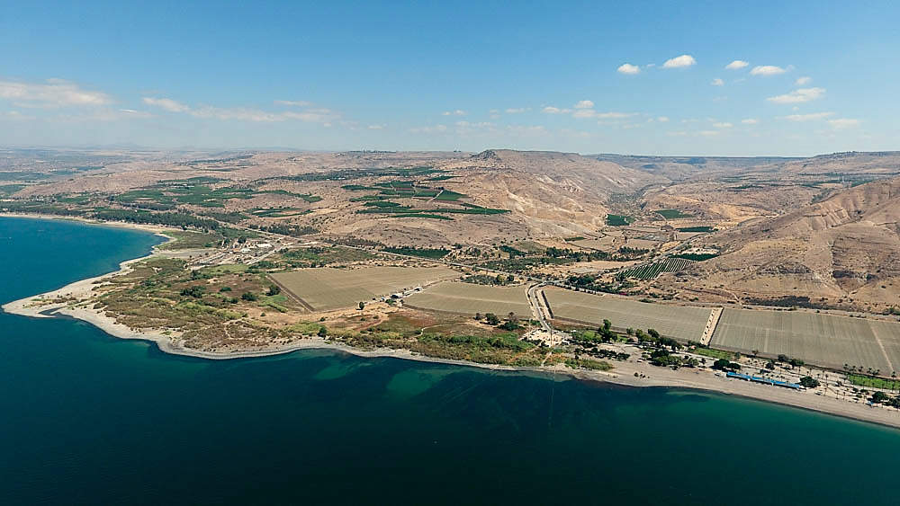
Golan Heights
Kursi church
tombs
harbor
slope

Slide 10
The Delivery of a Demoniac
Mark 5:1-20
The Gospel According to Mark
THE CONFRONTATION WITH MULTIPLE DEMONS (vs. 1-13)
The District (vs. 1)
The Demoniac (vs. 2-5)
- “immediately a man…with an unclean spirit”
- “he had his dwelling among the tombs”

Slide 11
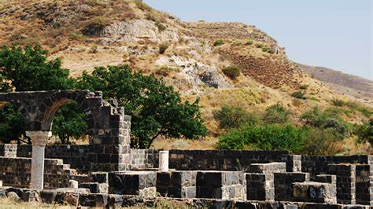

Slide 12
The Delivery of a Demoniac
Mark 5:1-20
The Gospel According to Mark
THE CONFRONTATION WITH MULTIPLE DEMONS (vs. 1-13)
The District (vs. 1)
The Demoniac (vs. 2-5)
- “immediately a man…with an unclean spirit”
- “he had his dwelling among the tombs”
- “no one was able to bind him anymore…he had often been bound
with shackles and chains”
- “constantly, night and day, he was screaming…and gashing
himself with stones”

Slide 13
The Delivery of a Demoniac
Mark 5:1-20
The Gospel According to Mark
THE CONFRONTATION WITH MULTIPLE DEMONS (vs. 1-13)
The District (vs. 1)
The Demoniac (vs. 2-5)
The Dispute (vs. 6-13)
- “he ran up and bowed down” (c.f. 3:11)
- “What business do we have with each other, Jesus, Son of the
Most High God?” (c.f. 1:24)
- “I implore You by God, do not torment me!” (Revelation 20:10)
- “What is your name?” . . . “My name is Legion; for we are many.”
- “implore Him earnestly not to send them out of the country”

Slide 14
The Delivery of a Demoniac
Mark 5:1-20
The Gospel According to Mark
THE CONFRONTATION WITH MULTIPLE DEMONS (vs. 1-13)
The District (vs. 1)
The Demoniac (vs. 2-5)
The Dispute (vs. 6-13)
- “a large herd of swine feeding nearby on the mountain”
- “Send us into the swine so that we may enter them.”
- “Jesus gave them permission.”
- “the unclean spirits entered the swine; and the herd rushed down
the steep bank into the sea, about two thousand of them;
and they were drowned in the sea”

Slide 15
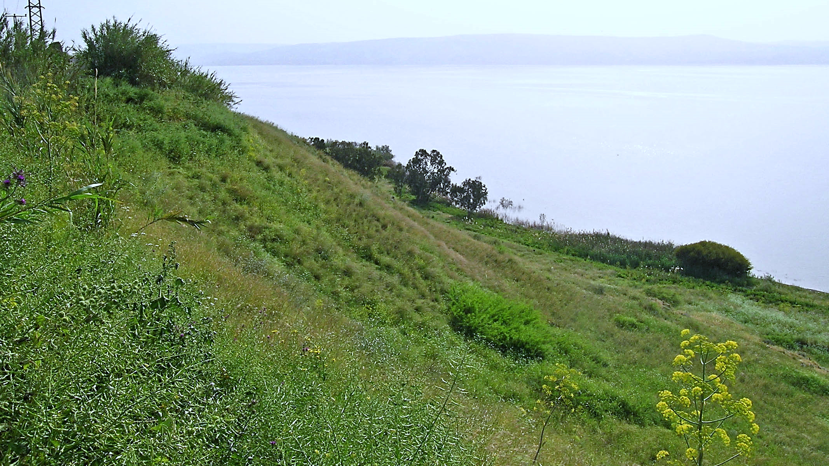

Slide 16
The Delivery of a Demoniac
Mark 5:1-20
The Gospel According to Mark
THE CONFRONTATION WITH MULTIPLE DEMONS (vs. 1-13)
THE CONSULTATION WITH THE LIBERAGED DEMONIAC
His Countrymen (vs. 14-17)
- “Their herdsmen ran away and reported it in the city and in the
country.”
- “And the people came to see what it was that had happened.”
- “observed the man who had been demon-possessed sitting down,
clothed and in his right mind, the very man who had had the
‘legion’; and they became frightened.”
- “they began to implore Him to leave their region”
(vs. 14-20)

Slide 17
The Delivery of a Demoniac
Mark 5:1-20
The Gospel According to Mark
THE CONFRONTATION WITH MULTIPLE DEMONS (vs. 1-13)
THE CONSULTATION WITH THE LIBERAGED DEMONIAC
His Countrymen (vs. 14-17)
His Condition (18-19)
- “as He was getting into the boat, the man who had been demon-
possessed was imploring Him that he might accompany Him.
And He did not let him…”
- “but He said to him, ‘Go home to your people and report to them
what great things the Lord has done for you, and how He
had mercy on you.’ ”
(vs. 14-20)

Slide 18
The Delivery of a Demoniac
Mark 5:1-20
The Gospel According to Mark
THE CONFRONTATION WITH MULTIPLE DEMONS (vs. 1-13)
THE CONSULTATION WITH THE LIBERAGED DEMONIAC
His Countrymen (vs. 14-17)
His Condition (vs. 15, 18-19)
His Consecration (vs. 20)
- “And he went away and began to proclaim in Decapolis what
great things Jesus had done for him; and everyone was
amazed.”
(vs. 14-20)

Slide 19
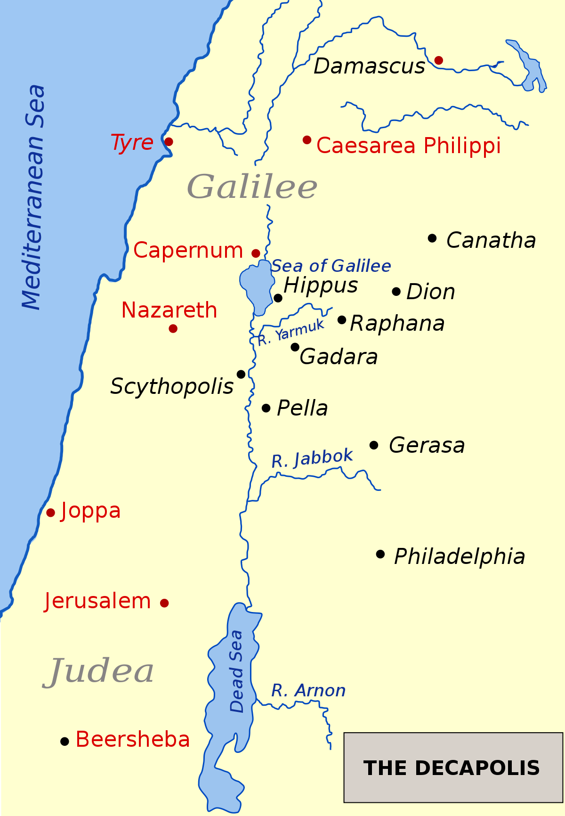
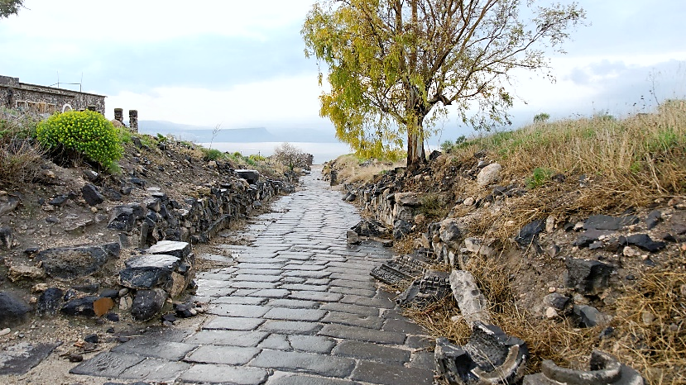
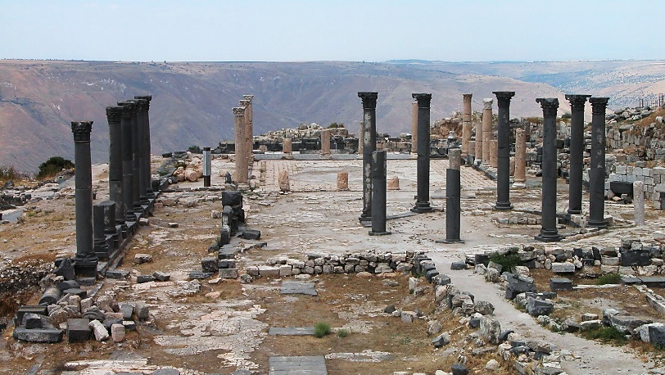
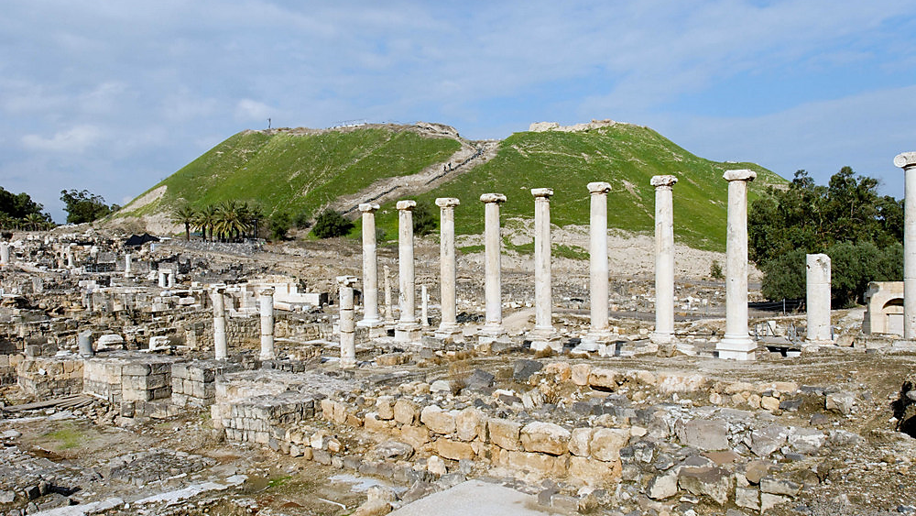
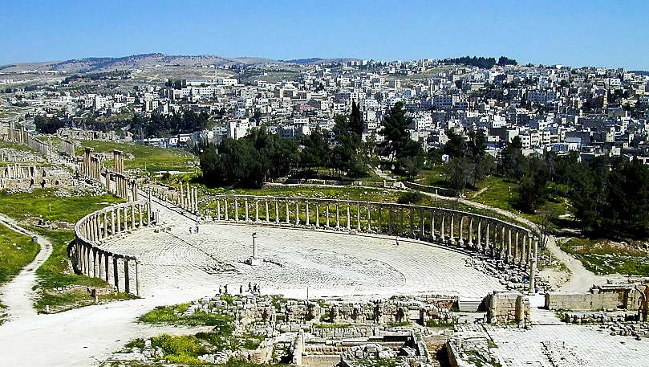
HIPPUS/SUSCITA
GADERA/UM QAIS
SCYTHOPOLIS/ BEIT SHAN
GERASA /JERASH

Slide 20
The Delivery of a Demoniac
Mark 5:1-20
The Gospel According to Mark
Conclusion:
Demons are real and dangerous.
Demons can inflict serious personal injury on the one possessed, and on others.
Demons recognize and are subject to appropriate spiritual authority.
We do not have the same authority as Jesus, but we can seek His authority when confronted with a case of demon influence.
You can take full confidence in the fact that “greater is He that is in you than he that is in the world” (I John 4:4).

