Slide 2
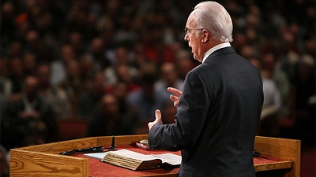
What just happened here?
Mark 16 (ending)
The Gospel According to Mark

Slide 3
What just happened here?
Mark 16 (ending)
The Gospel According to Mark
WHAT ARE THE OPTIONS?
Mark’s gospel ends at vs. 8.
- Option #1: an original longer ending was lost at some point
- Option #2: this is the original and intended ending

Slide 4
What just happened here?
Mark 16 (ending)
The Gospel According to Mark
WHAT ARE THE OPTIONS?
Mark’s gospel ends at vs. 8.
B. Verses 9-20 are part of the original.
- Mark himself added it later as a conclusion to Peter’s memorabilia
- another author, inspired by the Holy Spirit, added it later

Slide 5
What just happened here?
Mark 16 (ending)
The Gospel According to Mark
WHAT ARE THE OPTIONS?
Mark’s gospel ends at vs. 8.
B. Verses 9-20 are part of the original.
C. There should also be more after vs. 20.
“They reported briefly to those around Peter all that they had been commanded. After these things Jesus himself sent out through them, from the east to the west, the holy and imperishable preaching of eternal salvation. Amen.”
KJV: “And they went forth, and preached every where, the Lord working with them, and confirming the word with signs following. Amen.”

Slide 6
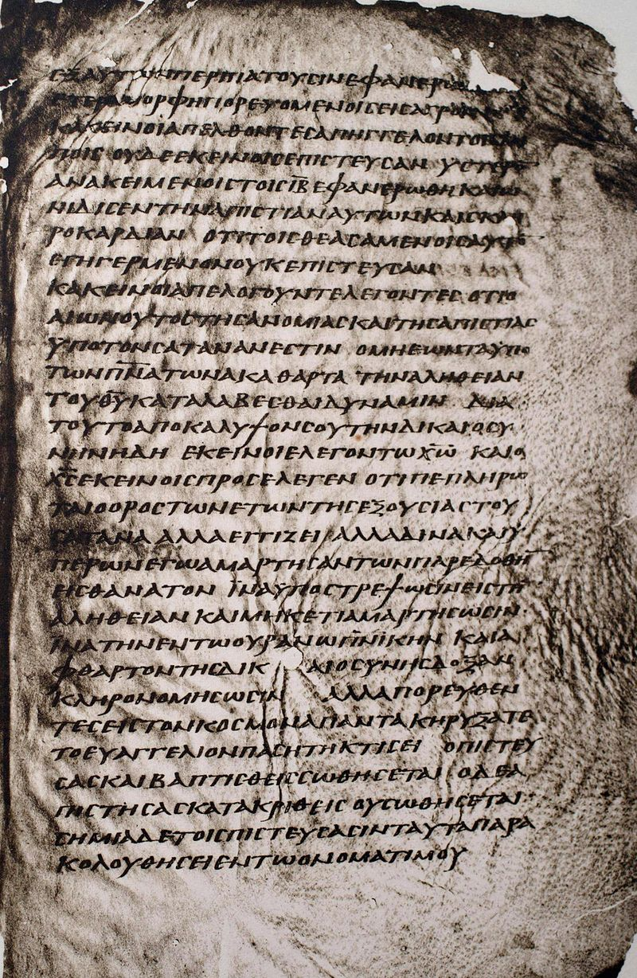
Includes the “Freer Logion” (additional verses):
And they excused themselves, saying, "This age of lawlessness and unbelief is under Satan, who does not allow the truth and power of God to prevail over the unclean things of the spirits. Therefore, reveal your righteousness now" – thus they spoke to Christ. And Christ replied to them, "The term of years of Satan's power has been fulfilled, but other terrible things draw near. And for those who have sinned I was handed over to death, that they may return to the truth and sin no more, in order that they may inherit the spiritual and incorruptible glory of righteousness that is in heaven.”
Codex Washingtonianus
(4/5th century)

Slide 7
What just happened here?
Mark 16 (ending)
The Gospel According to Mark
WHAT ARE THE OPTIONS?
THE EXTERNAL EVIDENCE
Manuscript Evidence
Codex Vaticanus (325-350) and Codex Sinaiticus (330-360)

Slide 8
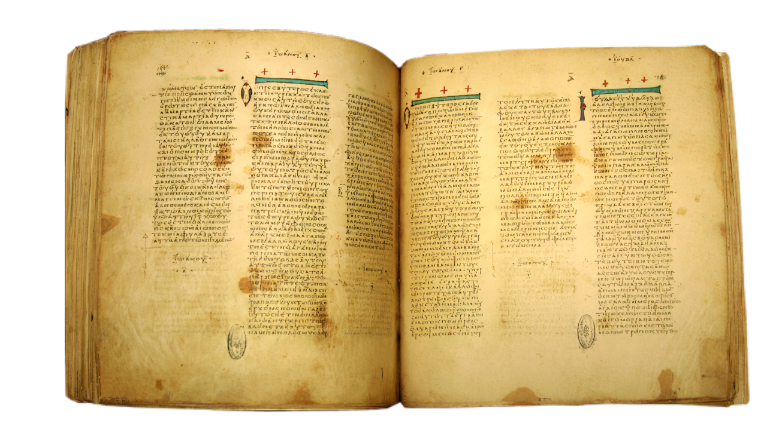
Codex Vaticanus
(4th century)

Slide 9
What just happened here?
Mark 16 (ending)
The Gospel According to Mark
WHAT ARE THE OPTIONS?
THE EXTERNAL EVIDENCE
Manuscript Evidence
The “Majority Text” (AKA: Byzantine Text, later Textus Receptus)
- began at the Council of Nicea (325) when Eusebius distributed
new copies of the Bible in exchange for older manuscripts
- consequently, we have c. 1,200 copies of Mark, many from this
“Byzantine Text”
- in 1516, Erasmus printed the first full Greek New Testament
- this eventually led to a Textus Receptus (the basis for the 1611 KJV)

Slide 10
What just happened here?
Mark 16 (ending)
The Gospel According to Mark
WHAT ARE THE OPTIONS?
THE EXTERNAL EVIDENCE
Manuscript Evidence
The Textus Receptus
Early Church Fathers
- Eusebius (265-339) and Jerome (347-420) acknowledged that
most Greek manuscripts ended with vs. 8
- however, Justin Martyr, Tatian, and Irenaeus (all from the 2nd
century) quote from this spurious section

Slide 11
What just happened here?
Mark 16 (ending)
The Gospel According to Mark
WHAT ARE THE OPTIONS?
THE EXTERNAL EVIDENCE
Manuscript Evidence
The Textus Receptus
Early Church Fathers
How the Bible Came to Us

Slide 12
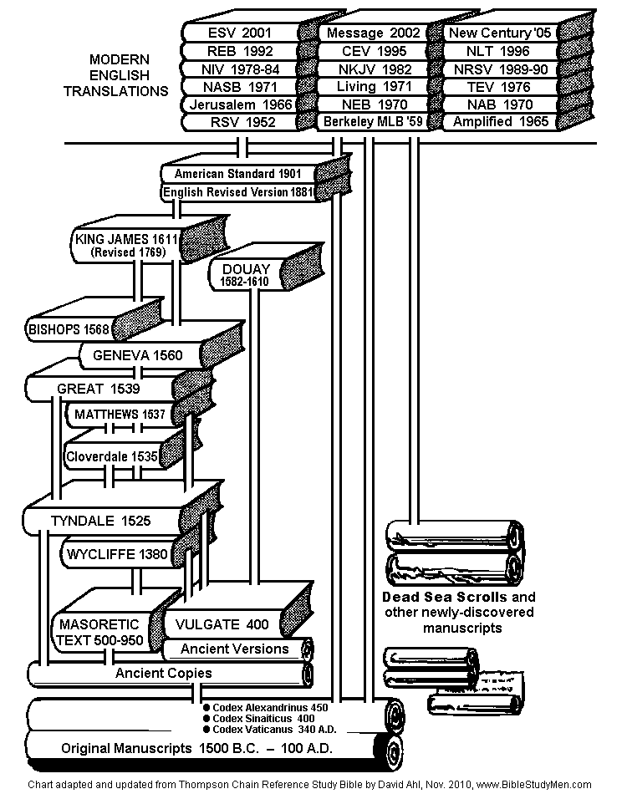
Summary of process…
English language translations
Hebrew and Greek “eclectic”
texts
hand copies (“families of
texts”) until Gutenberg’s press in 1452
translations (Septuagint,
Syriac, Aramaic, Vulgate)
original autographs, early
copies, multiple copies

Slide 13
What just happened here?
Mark 16 (ending)
The Gospel According to Mark
WHAT ARE THE OPTIONS?
THE EXTERNAL EVIDENCE
Manuscript Evidence
The Textus Receptus
Early Church Fathers
How the Bible Came to Us
Conclusion:
- This ending came into existence early but there was anything but
uniform acceptance of it.
- The external evidence is sufficient to exclude it.

Slide 14
What just happened here?
Mark 16 (ending)
The Gospel According to Mark
WHAT ARE THE OPTIONS?
THE EXTERNAL EVIDENCE
THE INTERNAL EVIDENCE
the transition is awkward
the contents are still missing some necessary details
the vocabulary and style has some significant differences
some of the contents are highly questionable
nearly everything here comes from the other Gospels and Acts
Conclusion: - The internal evidence is sufficient to exclude it.

Slide 15
What just happened here?
Mark 16 (ending)
The Gospel According to Mark
WHAT ARE THE OPTIONS?
THE EXTERNAL EVIDENCE
THE INTERNAL EVIDENCE
Conclusion:
Why did this happen?
How should we handle it?
Can I still trust my Bible?

